Slide 1
TOEFL-Listening Practice Session 2
Sentence Structure + Practice
Group9120

Slide 2
Conversation
MALE STUDENT:
Yeah... actually my roommate had a small part in it. FEMALE PROFESSOR:
Really? I was impressed with the performance - there sure are some talented people here! What did you think?
Group9120

Slide 3
Conversation
Very fast
Very Colloquial
Fragmented
MALE STUDENT:
Yeah... actually my roommate had a small part in it. FEMALE PROFESSOR:
Really? I was impressed with the performance - there sure are some talented people here! What did you think?
Group9120

Slide 4
Conversation
Very fast
Very Colloquial
Fragmented
Speed
MALE STUDENT:
Yeah... actually my roommate had a small part in it. FEMALE PROFESSOR:
Really? I was impressed with the performance - there sure are some talented people here! What did you think?
Group9120

Slide 5
Conversation
Very fast
Very Colloquial
Fragmented
Speed
MALE STUDENT:
Yeah... actually my roommate had a small part in it. FEMALE PROFESSOR:
Really? I was impressed with the performance - there sure are some talented people here! What did you think?
But the alligators would escape and find their way into the New York sewer system where they started reproducing, grew to huge sizes, and now strike fear into sewer workers.
Lecture
Group9120

Slide 6
Conversation
Very fast
Very Colloquial
Fragmented
Speed
MALE STUDENT:
Yeah... actually my roommate had a small part in it. FEMALE PROFESSOR:
Really? I was impressed with the performance - there sure are some talented people here! What did you think?
But the alligators would escape and find their way into the New York sewer system where they started reproducing, grew to huge sizes, and now strike fear into sewer workers.
Accuracy
Formal
Very complex
Reading
The first farmers, who may have lived as long as 10,000 years ago, undoubtedly used simple techniques and still relied primarily on other forms of food production, such as hunting, foraging, or pastoralism.
Lecture
Group9120

Slide 7
Conversation
Very fast
Very Colloquial
Fragmented
Speed
MALE STUDENT:
Yeah... actually my roommate had a small part in it. FEMALE PROFESSOR:
Really? I was impressed with the performance - there sure are some talented people here! What did you think?
But the alligators would escape and find their way into the New York sewer system where they started reproducing, grew to huge sizes, and now strike fear into sewer workers.
Accuracy
Formal
Very complex
Reading
The first farmers, who may have lived as long as 10,000 years ago, undoubtedly used simple techniques and still relied primarily on other forms of food production, such as hunting, foraging, or pastoralism.
Lecture
Fast
Colloquial
Complex
Speed & Accuracy
Group9120

Slide 8

TPO 14 – Conversation 2
Prepare for a Career in Journalism
Tell us:
What is the main idea?
What topics are involved?
Let’s warm up!
Listen to a conversation between a student and his faculty advisor…
Group9120

Slide 9

Intro:
(usually the first 30 seconds)
Conversation
TPO 14-4
Student’s reporting
Topic 1:
(usually the next 30-60 seconds)
Major transfer
Topic 2:
(usually the next 30-60 seconds)
Why journalism not offered
Topic 3:
(usually the next 30-60 seconds)
Major recommendation

Slide 10
Intro:
00:00-01:04 (first 30s)
Conversation
TPO 14-4
NARRATOR: Listen to a conversation between a student and his faculty advisor.
FEMALE ADVISOR: Hi, Steve, I scheduled this appointment ‘cause it’s been a while since we touched base.
MALE STUDENT: I know, I’ve been really busy. A friend of mine works on the school paper. He asked me if I would like to try to reporting. So I did and I really love it.
FEMALE ADVISOR: Hey... that's sounds great!
MALE STUDENT: Yeah... the first article I wrote, it was a profile of the chemistry professor, the one who was the named teacher of the year. My article ran on the front page. When I saw my name, I mean, my byline in print, I was hooked. Now I know this is what I want to do - be a reporter.
FEMALE ADVISOR: Isn't it great to discover something that you really enjoy? And I read that article too. It was very good.
MALE STUDENT: To be honest, the articles got a lot of editing. In fact I barely recognized a couple of paragraphs. But the editor explained why the changes were made. I learned a lot and my second article didn't need nearly as many changes.
FEMALE ADVISOR: Sound like you’ve got a real knack for this.
MALE STUDENT: Yeah... anyway, I am glad you schedule this meeting because I want to change my major to journalism now.
3-4 Summarize
6-9 Summarize

Slide 11
Intro:
00:00-01:04 (first 30s)
Conversation
TPO 14-4
NARRATOR: Listen to a conversation between a student and his faculty advisor.
FEMALE ADVISOR: Hi, Steve, I scheduled this appointment ‘cause it’s been a while since we touched base.
MALE STUDENT: I know, I’ve been really busy. A friend of mine works on the school paper. He asked me if I would like to try reporting. So I did and I really love it.
FEMALE ADVISOR: Hey... that's sounds great!
MALE STUDENT: Yeah... the first article I wrote, it was a profile of the chemistry professor, the one who was the named teacher of the year. My article ran on the front page. When I saw my name, I mean, my byline in print, I was hooked. Now I know this is what I want to do - be a reporter.
FEMALE ADVISOR: Isn't it great to discover something that you really enjoy? And I read that article too. It was very good.
MALE STUDENT: To be honest, the articles got a lot of editing. In fact I barely recognized a couple of paragraphs. But the editor explained why the changes were made. I learned a lot and my second article didn't need nearly as many changes.
FEMALE ADVISOR: Sound like you’ve got a real knack for this.
MALE STUDENT: Yeah... anyway, I am glad you schedule this meeting because I want to change my major to journalism now.
6-9 Summarize

Slide 12
Intro:
00:00-01:04 (first 30s)
Conversation
TPO 14-4
NARRATOR: Listen to a conversation between a student and his faculty advisor.
FEMALE ADVISOR: Hi, Steve, I scheduled this appointment ‘cause it’s been a while since we touched base.
MALE STUDENT: I know, I’ve been really busy. A friend of mine works on the school paper. He asked me if I would like to try reporting. So I did and I really love it.
FEMALE ADVISOR: Hey... that's sounds great!
MALE STUDENT: Yeah... the first article I wrote, it was a profile of the chemistry professor, the one who was the named teacher of the year. My article ran on the front page. When I saw my name, I mean, my byline in print, I was hooked. Now I know this is what I want to do - be a reporter.
FEMALE ADVISOR: Isn't it great to discover something that you really enjoy? And I read that article too. It was very good.
MALE STUDENT: To be honest, the articles got a lot of editing. In fact I barely recognized a couple of paragraphs. But the editor explained why the changes were made. I learned a lot and my second article didn't need nearly as many changes.
FEMALE ADVISOR: Sound like you’ve got a real knack for this.
MALE STUDENT: Yeah... anyway, I am glad you schedule this meeting because I want to change my major to journalism now.

Slide 13
Intro:
(usually the first 30 seconds)
Conversation
TPO 14-4
Student’s reporting
Topic 1:
(usually the next 30-60 seconds)
Major transfer
Topic 2:
(usually the next 30-60 seconds)
Why journalism not offered
Topic 3:
(usually the next 30-60 seconds)
Major recommendation

Slide 14
Topic 1:
01:04-01:18 (30-60s)
Conversation
TPO 14-4
MALE STUDENT: Yeah... anyway, I am glad you schedule this meeting because I want to change my major to journalism now. FEMALE ADVISOR: Um... the university doesn't offer major in journalism. MALE STUDENT: Oh no... FEMALE ADVISOR: But... MALE STUDENT: I... I mean... should I transfer to another school, or major in English? FEMALE ADVISOR: Er... wait a minute. Let me explain why the major isn't offered.

Slide 15
Intro:
(usually the first 30 seconds)
Conversation
TPO 14-4
Student’s reporting
Topic 1:
(usually the next 30-60 seconds)
Major transfer
Topic 2:
(usually the next 30-60 seconds)
Why journalism not offered
Topic 3:
(usually the next 30-60 seconds)
Major recommendation

Slide 16
Topic 2:
01:19-02:03 (30-60s)
Conversation
TPO 14-4
FEMALE ADVISOR: Er... wait a minute. Let me explain why the major isn't offered. Editors at the newspapers... editors... um...I mean, when you apply for a reporting job, editors look at the two things: they want to see clips, you know, some of your published articles; they also want you to try out. They'll give you an assignment like... covering a press conference or some other event, then see if you can craft the story about it, accurately, on deadline. MALE STUDENT: So they don't even to look at my major? FEMALE ADVISOR: It is not that they don't look at it... it is... well, having a degree in something other than journalism should actually work to your advantage. MALE STUDENT: How? FEMALE ADVISOR: Most journalists specialized these days. They only write about science or business or technology for example. Is there a type of reporting you think you may like to specialize then?
23 - Summarize

Slide 17
Topic 2:
01:19-02:03 (30-60s)
Conversation
TPO 14-4
FEMALE ADVISOR: Er... wait a minute. Let me explain why the major isn't offered. Editors at the newspapers... editors... um...I mean, when you apply for a reporting job, editors look at the two things: they want to see clips, you know, some of your published articles; they also want you to try out. They'll give you an assignment like... covering a press conference or some other event, then see if you can craft the story about it, accurately, on deadline. MALE STUDENT: So they don't even to look at my major? FEMALE ADVISOR: It is not that they don't look at it... it is... well, having a degree in something other than journalism should actually work to your advantage. MALE STUDENT: How? FEMALE ADVISOR: Most journalists specialized these days. They only write about science or business or technology for example. Is there a type of reporting you think you may like to specialize then?

Slide 18
Intro:
(usually the first 30 seconds)
Conversation
TPO 14-4
Student’s reporting
Topic 1:
(usually the next 30-60 seconds)
Major transfer
Topic 2:
(usually the next 30-60 seconds)
Why journalism not offered
Topic 3:
(usually the next 30-60 seconds)
Major recommendation

Slide 19
Topic 3:
02:04-02:43 (30-60s)
Conversation
TPO 14-4
MALE STUDENT: Well... I think it can be really cool to cover the Supreme Court. I mean... their decision affects so many people. FEMALE ADVISOR: That is really a goal worth striving for. So, why not continue major in political science? And, as electives, you could take some Pre-Law classes like constitutional Law, and as for you work on the student newspaper paper, maybe they let you cover some local court cases once that the student and professor here would want to read about. MALE STUDENT: Do you know of any? FEMALE ADVISOR: I do, actually. There is case involving this computer software program that one of our professors wrote. The district courts decide in if the university is entitled to any of the professors' profits. MALE STUDENT: Wow... I will definitely follow up on that!
32-33 - Summarize
35-36 - Paraphrase

Slide 20
Topic 3:
02:04-02:43 (30-60s)
Conversation
TPO 14-4
MALE STUDENT: Well... I think it can be really cool to cover the Supreme Court. I mean... their decision affects so many people. FEMALE ADVISOR: That is really a goal worth striving for. So, why not continue major in political science? And, as electives, you could take some Pre-Law classes like constitutional Law, and as for you work on the student newspaper paper, maybe they’ll let you cover some local court cases, ones that the student and professor here would want to read about. MALE STUDENT: Do you know of any? FEMALE ADVISOR: I do, actually. There is case involving this computer software program that one of our professors wrote. The district courts decide in if the university is entitled to any of the professors' profits. MALE STUDENT: Wow... I will definitely follow up on that!
35-36 - Paraphrase

Slide 21
Topic 3:
02:04-02:43 (30-60s)
Conversation
TPO 14-4
MALE STUDENT: Well... I think it can be really cool to cover the Supreme Court. I mean... their decision affects so many people. FEMALE ADVISOR: That is really a goal worth striving for. So, why not continue major in political science? And, as electives, you could take some Pre-Law classes like constitutional Law, and as for you work on the student newspaper paper, maybe they’ll let you cover some local court cases, ones that the student and professor here would want to read about. MALE STUDENT: Do you know of any? FEMALE ADVISOR: I do, actually. There is case involving this computer software program that one of our professors wrote. The district courts decide in if the university is entitled to any of the professors' profits. MALE STUDENT: Wow... I will definitely follow up on that!
The is a case involving a computer program written by our professor. The court will decide if the university is entitled to the profit.

Slide 22
TPO 14 – Conversation 2
Prepare for a Career in Journalism
Tell us:
What is the main idea?
What topics are involved?
Let’s warm up!
Listen to a conversation between a student and his faculty advisor…
Group9120

Slide 23
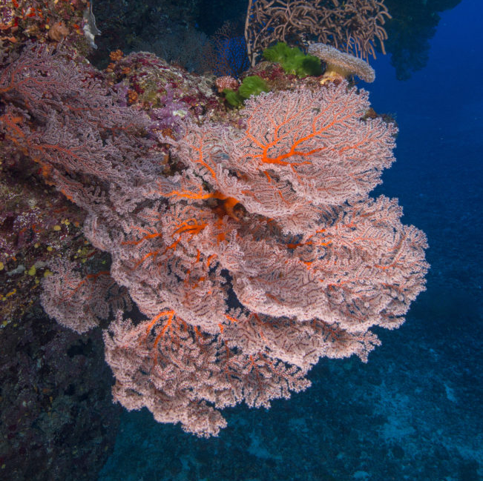
TPO27 Lecture 1 Coral Reef Marines
Related reading material:
TPO66 – Passage 3 What is coral?
http://top.zhan.com/toefl/read/practicereview-2462-13.html

Slide 24
Related Vocabulary
1 coral reef 珊瑚礁
2 limestone skeleton 石灰石骨骼
3 coral bleaching 珊瑚白化 (bleach 漂白剂)
4 degradation 降解 (de - down/off)
5 reestablish 恢复
6 paramount 最重要的 (para - beyond, mount - climb/up)
7 refugia 避难所 (refugee)
8 vicinity 周边地区
9 thorough 彻底的

Slide 25
TOEFL Life Science Structures
Animal species
Animals
Characteristics of animals
Animals’ living environments and changes
(may have been caused by human)

Slide 26
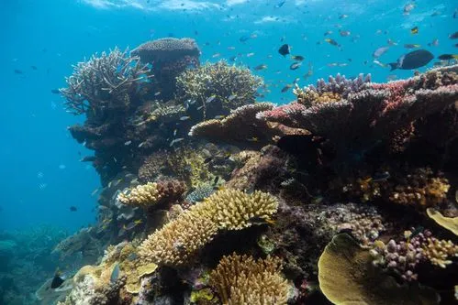
Let’s get to know coral reefs first!
Coral reefs are beautiful, colorful and the cornerstone of a healthy ocean ecosystem. Often called the ‘rainforest of the seas’ - they host an abundant variety of sea life - crucial habitat for about 25% of all ocean species! They look like a plant, but coral reefs are considered animals - they are invertebrates belonging to a group of animals called Cnidaria. Other animals in this group include jellyfish and sea anemones. Coral reefs are made up of tiny organisms called polyps. The polyps are soft-bodied but secrete limestone skeletons for support. Large, iconic reefs are formed when many, many polyps come together and build on one another. The result is a colony of polyps that actually act as one organism!
https://oceanconservancy.org/blog/2018/12/06/what-is-coral-reef/?ea.tracking.id=18HPXWJBXX&gclid=Cj0KCQjwwJuVBhCAARIsAOPwGASernXrvE6MnnVpCsIX69slnjsCWbxG-bz1JmHCx5udZCWJNcAGG9saAuTGEALw_wcB

Slide 27
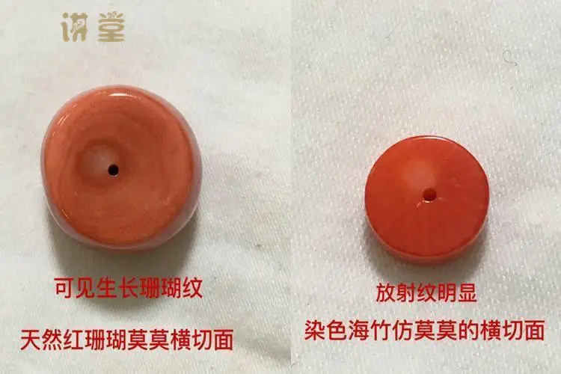
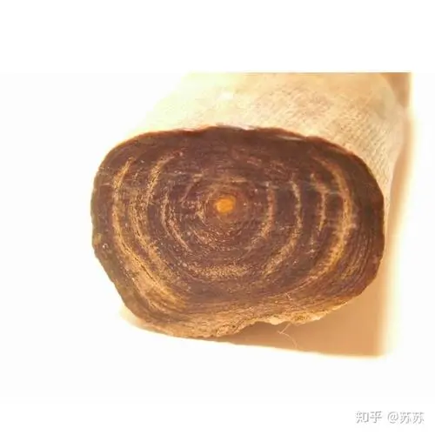
Corals can be much older than your grandparents!
Some coral can live for over 4,000 years! You might be wondering - how can scientists tell the age of a coral? Similar to tree trunks, cross-sections reveal coral-growth rings that can be used to determine their age - and information about climate.
The coral’s hard calcium carbonate skeletons contain bands, like tree rings, that record environmental changes in temperature, water chemistry and water clarity. Scientists can extract, or “core” out, a long, thin cylinder of calcium carbonate from large stony corals, and count the stripes and examine their width. These records help scientists reconstruct what past ages were like before humans kept records!

Slide 28
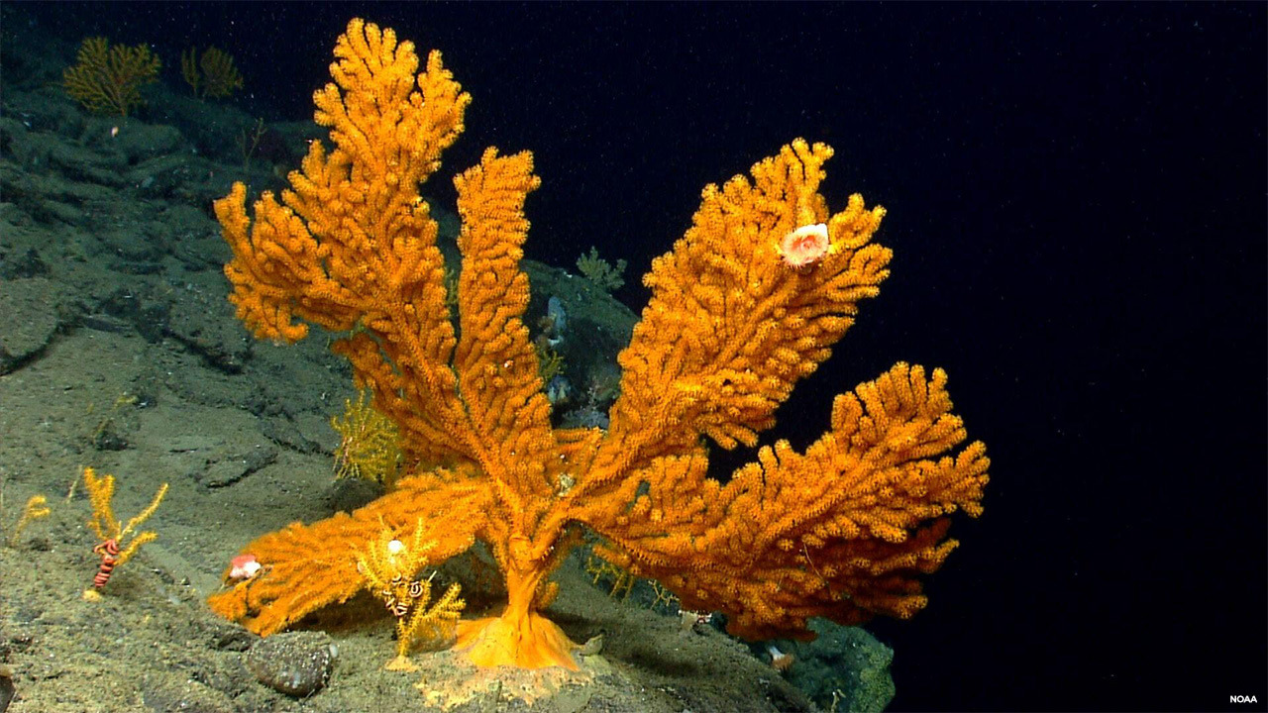
Do the coral reefs only exist in warm places?
Coral aren’t only found in warm tropical waters. Coral have been found up to 20,000 feet below the ocean’s surface, where the water is icy cold and the light dim or absent. In fact, scientists have discovered nearly as many species of deep-sea corals (also known as cold-water corals) as shallow-water species.
Like shallow-water corals, deep-sea corals may exist as individual coral polyps, as diversely-shaped colonies containing many polyps of the same species, and as reefs with many colonies made up of one or more species. Unlike shallow-water corals, however, deep-sea corals don’t need sunlight. They obtain the energy and nutrients they need to survive by trapping tiny organisms in passing currents.
Coral reefs have been discovered in the North Atlantic and several species of deep-sea corals form an underwater garden off the coast of Alaska’s Aleutian Islands.
https://www.northeastoceandata.org/deep-sea-coral-management-areas-updated-on-northeast-ocean-data/

Slide 29
Now, listen to the introduction and try to summarize!
0:00 - 0:38

Slide 30
FEMALE PROFESSOR:
So we have been fairly thorough in our discussion about coral reefs, which of course are prominent, oceanic features made of hard limestone skeletons produced by tiny coral animals. We‘ve gone over where coral reefs are usually formed...along the edges of shallow ocean banks in tropical or subtropical regions, and the fact that they are declining at an alarming rate. But I don’t want to leave you with the impression that all is lost. There are several techniques being employed today that could prove useful in assuring the future of the reefs.
Main Idea:
Coral reefs are made of limestone skeletons and usually formed in warm regions. The number of coral reefs is declining rapidly.
However, there are some techniques being used to prevent their disappearances.

Slide 31
FEMALE PROFESSOR:
So we have been fairly thorough in our discussion about coral reefs, which of course are prominent, oceanic features made of hard limestone skeletons produced by tiny coral animals.
We've gone over where coral reefs are usually formed...along the edges of shallow ocean banks in tropical or subtropical regions, and the fact that they are declining at an alarming rate.
But I don’t want to leave you with the impression that all is lost. There are several techniques being employed today that could prove useful in assuring the future of the reefs.
Sentence 2
Sentence 3

Slide 32
FEMALE PROFESSOR:
So we have been fairly thorough in our discussion about coral reefs, which of course are prominent, oceanic features made of hard limestone skeletons produced by tiny coral animals.
We've gone over where coral reefs are usually formed...along the edges of shallow ocean banks in tropical or subtropical regions, and the fact that they are declining at an alarming rate.
But I don’t want to leave you with the impression that all is lost. There are several techniques being employed today that could prove useful in assuring the future of the reefs.
Sentence 3

Slide 33
FEMALE PROFESSOR:
So we have known that coral reefs are made up of hard limestone skeletons produced by tiny coral animals.
We've gone over where coral reefs are usually formed...along the edges of shallow ocean banks in tropical or subtropical regions, and the fact that they are declining at an alarming rate.
But I don’t want to leave you with the impression that all is lost. There are several techniques being employed today that could prove useful in assuring the future of the reefs.
Sentence 3

Slide 34
FEMALE PROFESSOR:
So we have been fairly thorough in our discussion about coral reefs, which of course are prominent, oceanic features made of hard limestone skeletons produced by tiny coral animals.
We've gone over where coral reefs are usually formed...along the edges of shallow ocean banks in tropical or subtropical regions, and the fact that they are declining at an alarming rate.
But I don’t want to leave you with the impression that all is lost. There are several techniques being employed today that could prove useful in assuring the future of the reefs.

Slide 35
FEMALE PROFESSOR:
So we have been fairly thorough in our discussion about coral reefs, which of course are prominent, oceanic features made of hard limestone skeletons produced by tiny coral animals.
We’ve already known that coral reefs usually are formed in tropical and subtropical regions, and the fact that they are declining rapidly.
But I don’t want to leave you with the impression that all is lost. There are several techniques being employed today that could prove useful in assuring the future of the reefs.

Slide 36

FEMALE PROFESSOR:
So we have been fairly thorough in our discussion about coral reefs, which of course are prominent, oceanic features made of hard limestone skeletons produced by tiny coral animals. We‘ve gone over where coral reefs are usually formed...along the edges of shallow ocean banks in tropical or subtropical regions, and the fact that they are declining at an alarming rate. But I don’t want to leave you with the impression that all is lost. There are several techniques being employed today that could prove useful in assuring the future of the reefs.
Techniques are about to follow : )

Slide 37
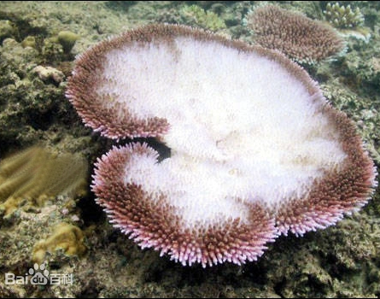
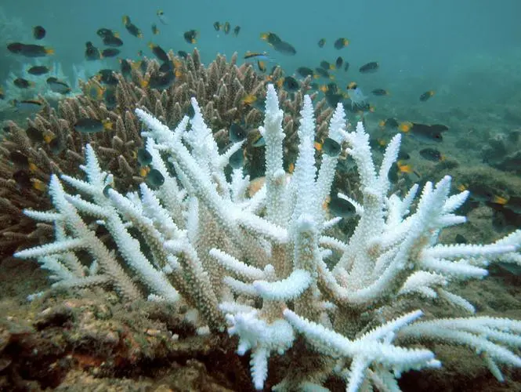
Why do coral reefs disappear? – coral bleaching
Before we can tell you about coral bleaching - we first need to tell you how a coral gets its color. Coral reefs get their colorful hues from algae called zooxanthellae. The coral polyps themselves are actually see-through!
Polyps and zooxanthellae have a symbiotic relationship, where coral polyps get their food from the algae in exchange for providing housing and protection to the algae. When coral get stressed out by things like pollution or high temperatures (often caused by climate change), the coral kick the zooxanthellae out. No algae=no color=coral bleaching. But, it’s a self-defeating response. Corals need the algae for food and to remain healthy—if the coral bleaching goes on for too long, it can actually kill the coral colony.

Slide 38
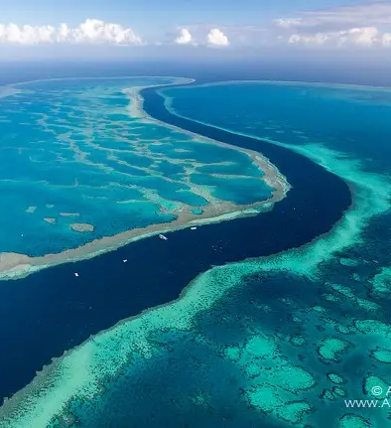
The Great Barrier Reef
The mass coral bleaching in the Great Barrier Reef has been making headlines all over the world. According to Scientific American:
During summer 2017, a large swath of Australia’s Great Barrier Reef—normally a riot of electric oranges, reds and other colors—turned ghostly pale. Unusually warm water temperatures, partly due to global warming, had caused the corals to expel from their tissues the symbiotic algae that provide them with food and give them their brilliant hues. It was the second mass-bleaching event to hit the reef in as many years. Together, the back-to-back events hit two-thirds of the reef.

Slide 39
So, what does the professor say about their disappearance?
0:39 – 1:18

Slide 40
Now, we've talked in depth about coral bleaching, or whitening, which as you recall, is a symptom of, well that the coral is suffering. As you know, coral is very sensitive to water temperature. Even though one or two degree Celsius rise in sea surface temperature for a relatively short amount of time can cause bleaching. Recently, researchers have used data collected by monitoring surface water temperatures to improve the ability of a reef to recover from bleaching. One future possibility is that improved monitoring can help predict where and when bleaching will occur, which might potentially enable us to mitigate its effects.
Main Idea:
Coral bleaching is a phenomenon that the coral is suffering and is caused by change of water temperature.
The first way to prevent coral bleaching is to monitor surface water temperature; there is also a future possibility to predict the locations and time of coral bleaching.

Slide 41
Now, we've talked in depth about coral bleaching, or whitening, which as you recall, is a symptom of, well that the coral is suffering. As you know, coral is very sensitive to water temperature. Even though one or two degree Celsius rise in sea surface temperature for a relatively short amount of time can cause bleaching. Recently, researchers have used data collected by monitoring surface water temperatures to improve the ability of a reef to recover from bleaching. One future possibility is that improved monitoring can help predict where and when bleaching will occur, which might potentially enable us to mitigate its effects.

Slide 42
1:18 – 2:29
Coral Transplantation
What is coral transplantation?
What is the advantage of coral transplantation?
What are the two disadvantages?
What is the professor’s attitude?

Slide 43
1:18 – 2:29
Coral Transplantation
What is coral transplantation?
Coral transplantation is a way to help coral recover by
moving young coral from a healthy reef onto a degraded reef.
What is the advantage of coral transplantation?
We don’t need to rely on the existing coral to
reestablish.
What are the two disadvantages?
The first one is that this method cost a lot of money, the second one is that this method couldn’t solve the essential
problem of coral bleaching.
What is the professor’s attitude?
The professor doesn’t agree with this opinion.

Slide 44
And there's another technique that's been experimented with to try to help coral reefs recover from bleaching. It's called coral transplantation. This involves moving young coral from a healthy reef onto a degraded reef, you know, in an attempt to regenerate the degraded reef by encouraging young healthy coral to take over. There has been some success with this, but it’s still somewhat controversial. Some scientists support it because, well for one thing, it means you don't have to rely on the existing coral to reestablish itself because it might not be able to. But in my opinion, transplanting coral should only be used as, well, as a last resort. I mean, this method is not only costly but it's...well, even if it's successful, it still fails to address the ongoing problem, the root causes of the degradation, which really is paramount to devising an effective solution. So I don't really take comfort in the successes they have had with transplantation.
Perhaps some more constructive use of our time could be spent at researching corals that do survive, like in areas known as refugia.
Main Idea:
Another way is coral transplantation, and it means that we need to transplant the healthy corals to a poor condition to help regenerate the degraded corals. Some scientists support it since we don’t have to rely on the existing corals, but the professor holds the opposite opinion. She thinks that it’s costly and doesn’t solve the core problem. Moreover, she points out that we should focus on researching the survival corals in refugia.

Slide 45
And there's another technique that's been experimented with to try to help coral reefs recover from bleaching. It's called coral transplantation. This involves moving young coral from a healthy reef onto a degraded reef, you know, in an attempt to regenerate the degraded reef by encouraging young healthy coral to take over. There has been some success with this, but it’s still somewhat controversial. Some scientists support it because, well for one thing, it means you don't have to rely on the existing coral to reestablish itself because it might not be able to. But in my opinion, transplanting coral should only be used as, well, as a last resort.
I mean, this method is not only costly but it's...well, even if it's successful, it still fails to address the ongoing problem, the root causes of the degradation, which really is paramount to devising an effective solution.
So I don't really take comfort in the successes they have had with transplantation. Perhaps some more constructive use of our time could be spent at researching corals that do survive, like in areas known as refugia.
Sentence 16

Slide 46
And there's another technique that's been experimented with to try to help coral reefs recover from bleaching. It's called coral transplantation. This involves moving young coral from a healthy reef onto a degraded reef, you know, in an attempt to regenerate the degraded reef by encouraging young healthy coral to take over. There has been some success with this, but it’s still somewhat controversial. Some scientists support it because, well for one thing, it means you don't have to rely on the existing coral to reestablish itself because it might not be able to. But in my opinion, transplanting coral should only be used as, well, as a last resort.
I mean, this method is not only costly but it's...well, even if it's successful, it still fails to address the ongoing problem, the root causes of the degradation, which really is paramount to devising an effective solution.
So I don't really take comfort in the successes they have had with transplantation. Perhaps some more constructive use of our time could be spent at researching corals that do survive, like in areas known as refugia.

Slide 47
And there's another technique that's been experimented with to try to help coral reefs recover from bleaching. It's called coral transplantation. This involves moving young coral from a healthy reef onto a degraded reef, you know, in an attempt to regenerate the degraded reef by encouraging young healthy coral to take over. There has been some success with this, but it’s still somewhat controversial. Some scientists support it because, well for one thing, it means you don't have to rely on the existing coral to reestablish itself because it might not be able to. But in my opinion, transplanting coral should only be used as, well, as a last resort.
I mean, this way is not only expensive, but also couldn’t be able to solve the essential problem, and is important for us to devise an effective solution.
So I don't really take comfort in the successes they have had with transplantation. Perhaps some more constructive use of our time could be spent at researching corals that do survive, like in areas known as refugia.

Slide 48
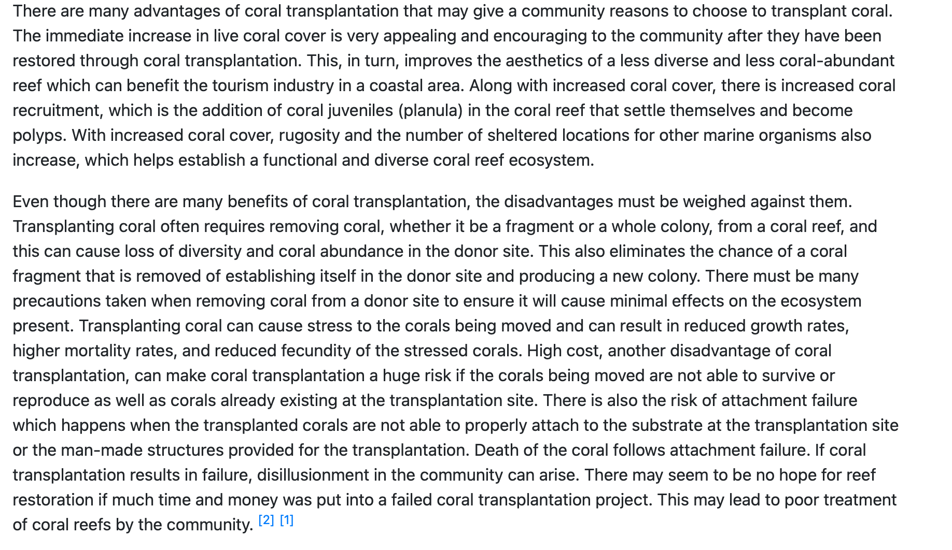
The advantages and disadvantage of Coral Transplantation
Advantages:
Beneficial for local tourism

Slide 49
What is refugia?
2:29 – 3:20

Slide 50
Refugia are areas on the reef that are seemingly, well resistant to bleaching. See, when coral reefs experience bleaching, it's rarely a case of the whole reef being affected. There are almost always pockets of coral on the reefs that remain unaffected. And these are often the lower areas of the reef, those located in deeper water, where temperatures are lower. Now, we have evidence that corals in these locations are able to escape the destructive bleaching that affects portions of the reef in shallower or warmer water. So in my mind, it's these refugia that are the key components of overall reef resilience. These should be the area of concentration for researchers to locate and protect those regions as a way to sustain coral reefs.
Main Idea:
Refugia are areas that are resistant to bleaching. They are located at lower areas of reefs in deeper water, where the water temperature is lower as well.
The professor also demonstrates there is evidence that refugia can protect corals. Therefore, scientists should concentrate on protecting the refugia to sustain the coral reefs.

Slide 51
Refugia are areas on the reef that are seemingly, well resistant to bleaching.
See, when coral reefs experience bleaching, it's rarely a case of the whole reef being affected.
There are almost always pockets of coral on the reefs that remain unaffected.
And these are often the lower areas of the reef, those located in deeper water, where temperatures are lower.
Now, we have evidence that corals in these locations are able to escape the destructive bleaching that affects portions of the reef in shallower or warmer water.
So in my mind, it's these refugia that are the key components of overall reef resilience.
These should be the area of concentration for researchers to locate and protect those regions as a way to sustain coral reefs.
Sentence 21
Sentence 22

Slide 52
Refugia are areas on the reef that are seemingly, well resistant to bleaching.
See, when coral reefs experience bleaching, it's rarely a case of the whole reef being affected.
There are almost always pockets of coral on the reefs that remain unaffected.
And these are often the lower areas of the reef, those located in deeper water, where temperatures are lower.
Now, we have evidence that corals in these locations are able to escape the destructive bleaching that affects portions of the reef in shallower or warmer water.
So in my mind, it's these refugia that are the key components of overall reef resilience.
These should be the area of concentration for researchers to locate and protect those regions as a way to sustain coral reefs.
Sentence 22

Slide 53
Refugia are areas on the reef that are seemingly, well resistant to bleaching.
See, when coral reefs experience bleaching, it's rarely a case of the whole reef being affected.
There are some regions could maintain unaffected on the reefs, and these regions usually located in deeper water, where the temperatures are lower.
Now, we have evidence that corals in these locations are able to escape the destructive bleaching that affects portions of the reef in shallower or warmer water.
So in my mind, it's these refugia that are the key components of overall reef resilience.
These should be the area of concentration for researchers to locate and protect those regions as a way to sustain coral reefs.
Sentence 22

Slide 54
Refugia are areas on the reef that are seemingly, well resistant to bleaching.
See, when coral reefs experience bleaching, it's rarely a case of the whole reef being affected.
There are almost always pockets of coral on the reefs that remain unaffected.
And these are often the lower areas of the reef, those located in deeper water, where temperatures are lower.
Now, we have evidence that corals in these locations are able to escape the destructive bleaching that affects portions of the reef in shallower or warmer water.
So in my mind, it's these refugia that are the key components of overall reef resilience.
These should be the area of concentration for researchers to locate and protect those regions as a way to sustain coral reefs.
Sentence 22

Slide 55
Refugia are areas on the reef that are seemingly, well resistant to bleaching.
See, when coral reefs experience bleaching, it's rarely a case of the whole reef being affected.
There are almost always pockets of coral on the reefs that remain unaffected.
And these are often the lower areas of the reef, those located in deeper water, where temperatures are lower.
Now, we have evidence that corals in these locations are able to escape the destructive bleaching that affects portions of the reef in shallower or warmer water.
So in my mind, it's these refugia that are the key components of overall reef resilience.
These should be the area of concentration for researchers to locate and protect those regions as a way to sustain coral reefs.

Slide 56
Refugia are areas on the reef that are seemingly, well resistant to bleaching.
See, when coral reefs experience bleaching, it's rarely a case of the whole reef being affected.
There are almost always pockets of coral on the reefs that remain unaffected.
And these are often the lower areas of the reef, those located in deeper water, where temperatures are lower.
Now, we know that coral in these regions could be able to escape the bleaching that would harm the parts of the reef in shallower and warmer places.
So in my mind, it's these refugia that are the key components of overall reef resilience.
These should be the area of concentration for researchers to locate and protect those regions as a way to sustain coral reefs.

Slide 57
Refugia are areas on the reef that are seemingly, well resistant to bleaching. See, when coral reefs experience bleaching, it's rarely a case of the whole reef being affected. There are almost always pockets of coral on the reefs that remain unaffected. And these are often the lower areas of the reef, those located in deeper water, where temperatures are lower. Now, we have evidence that corals in these locations are able to escape the destructive bleaching that affects portions of the reef in shallower or warmer water. So in my mind, it's these refugia that are the key components of overall reef resilience. These should be the area of concentration for researchers to locate and protect those regions as a way to sustain coral reefs. And we can also protect reefs by protecting the surrounding ecosystems, like mangrove forests and sea grass beds.
Ecosystems are about to follow : )

Slide 58
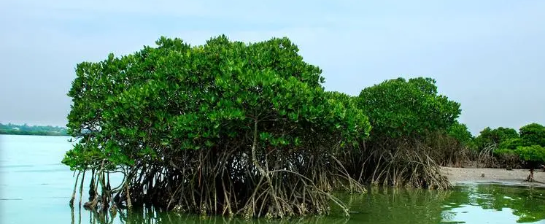
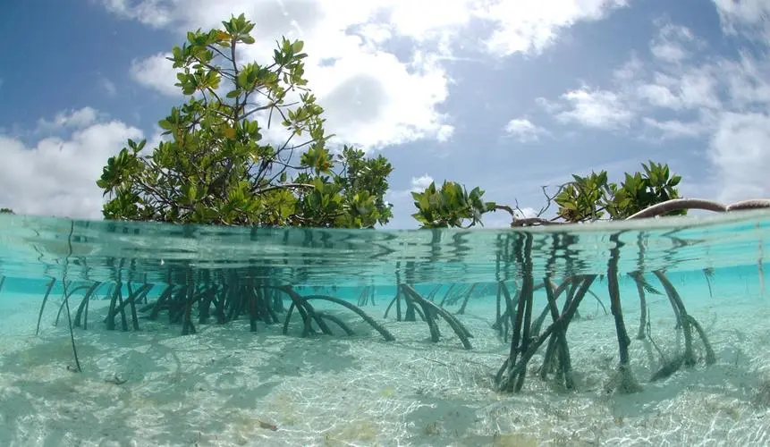
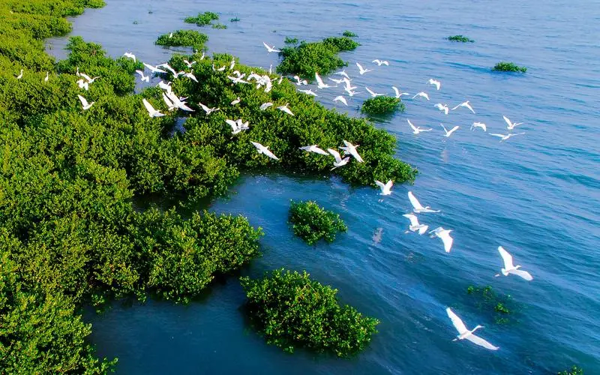
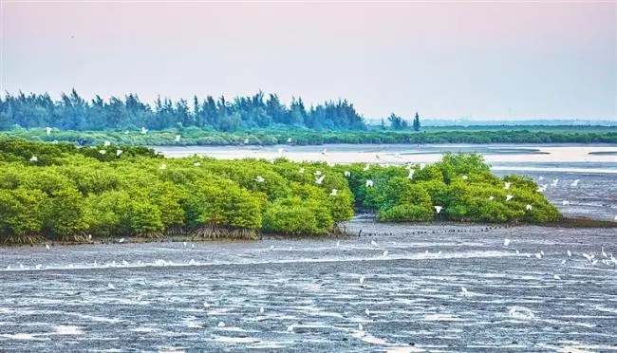

Slide 59
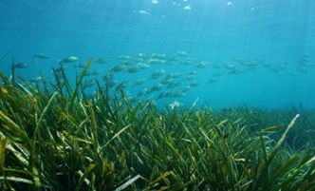
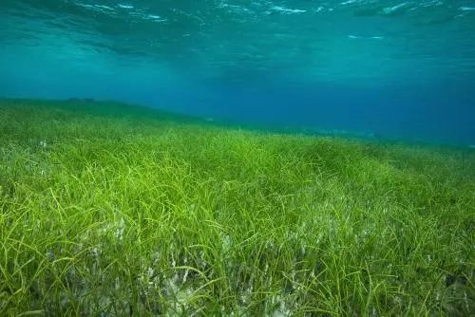
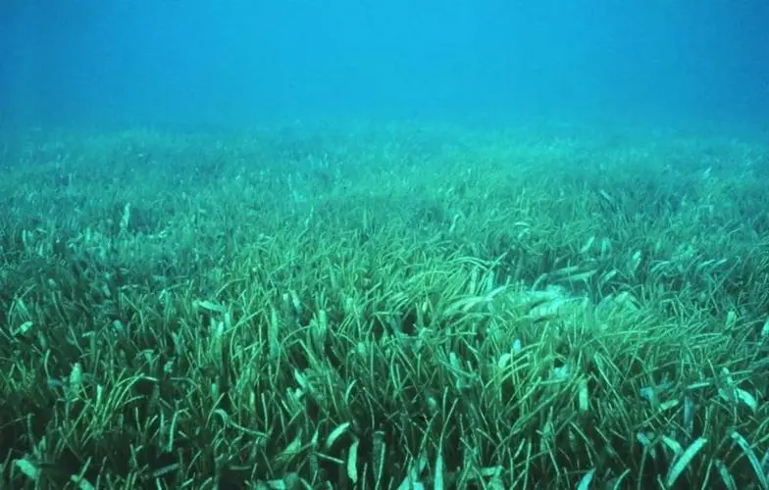
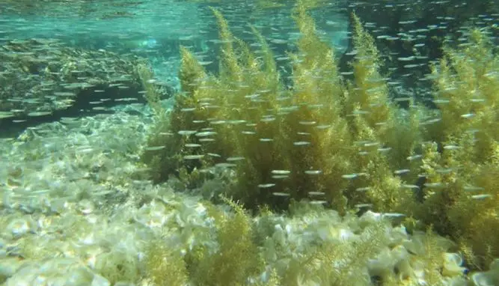

Slide 60
How does professor demonstrate the influences of these two kinds of surrounding ecosystem?
3:20 – 3:53

Slide 61
And we can also protect the reefs by protecting the surrounding ecosystems, like mangrove forests and seagrass beds. Both of these grow in coastal waters, often in the vicinity of coral reefs. By protecting these areas, we also protect the coral. Let's take, for example, the mangrove forests. Mangrove root systems have the ability to absorb and well trap sediments and pollutants in water that flows through them before they enter the ocean. This of course has beneficial results for the nearby coral reefs.
Main Idea:
By protecting mangrove forests and seagrass beds, we could also protect coral reefs, because mangrove forests are capable of absorbing and trapping the sediments and pollutants before they enter the ocean.

Slide 62
And we can also protect the reefs by protecting the surrounding ecosystems, like mangrove forests and forests and seagrass beds. Both of these grow in coastal waters, often in the vicinity of coral reefs. By protecting these areas, we also protect the coral. Let's take, for example, the mangrove forests. Mangrove root systems have the ability to absorb and well trap sediments and pollutants in water that flows through them before they enter the ocean. This of course has beneficial results for the nearby coral reefs

Slide 63
And we can also protect the reefs by protecting the surrounding ecosystems, like mangrove forests and seagrass beds. Both of these grow in coastal waters, often in the vicinity of coral reefs. By protecting these areas, we also protect the coral. Let's take, for example, the mangrove forests. Mangrove root systems have the ability to absorb and well trap sediments and pollutants in water that flows through them before they enter the ocean. This of course has beneficial results for the nearby coral reefs. And fisheries management is another key strategy.
Fisheries are about to follow : )

Slide 64
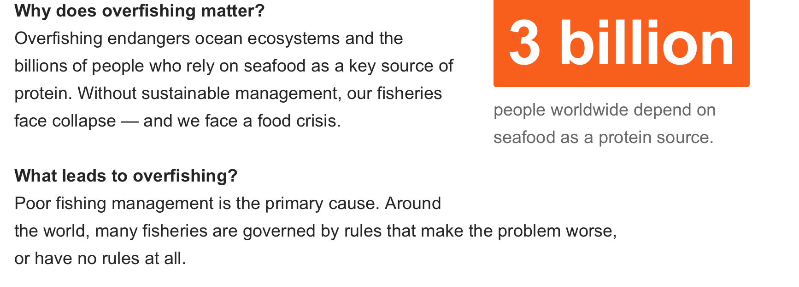

Slide 65
overfishing
3:53 – 4:36
Examples
？
？

Slide 66
overfishing
3:53 – 4:36
Examples
The first example is that some fishes would feed on the creatures that eat coral.
The second example is that some species, such as urchins, would eat algae to prevent the coral from being overwhelmed.

Slide 67
And fisheries management is another key strategy. Overfishing can be seriously disruptive to coral. Let me give you a couple of examples.
Overfishing certain species of fish and shellfish like snappers, barracudas and even lobsters. Well, all of these creatures feed on snails, worms and other organisms that eat coral. So depleting the number of lobsters, for example, means that we are adding to the threat of coral decline.
Sea urchins are another example. They eat algae and prevent it from overwhelming the coral. Since the disappearance of sea urchins from the waters up the coast of South Florida, many of coral reefs there have been smothered by the uncontrolled growth of algae.
Main Idea:
The other way to protect coral reefs is to manage overfishing, because fishes could help maintain the coral reefs. The professor illustrates with two examples: some fishes would feed on the creatures that eat coral. In addition, urchins would eat algae to prevent the coral from being overwhelmed.

Slide 68
And fisheries management is another key strategy. Over fishing can be seriously disruptive to coral. Let me give you a couple of examples. Overfishing certain species of fish and shellfish like snappers, barracudas and even lobsters. Well, all of these creatures feed on snails, worms and other organisms that eat coral. So depleting the number of lobsters, for example, means that we are adding to the threat of coral decline. Sea urchins are another example. They eat algae and prevent it from overwhelming the coral. Since the disappearance of sea urchins from the waters up the coast of South Florida, many of coral reefs there have been smothered by the uncontrolled growth of algae.

Slide 69
Now, let’s listen to the whole lecture again and answer the questions!

Slide 70
1. What is the lecture mainly about?
A. The transplantation of young coral to new reef sites
B. Efforts to improve the chances of survival of coral reefs
C. The effects of temperature change on coral reefs
D. Confirming the reasons behind the decline of coral reefs
3.What is the professor's opinion about coral transplantation?
A. It is cost-effective.
B. It is long-term solution.
C. It is producing encouraging results.
D. It does not solve the underlying problems.
2. According to the professor, how might researches predict the onset of coral bleaching in the future?
A. By monitoring populations of coral predators
B. By monitoring bleach-resistant coral species
C. By monitoring sea surface temperatures
D. By monitoring degraded reefs that have recovered

Slide 71
4.Why does the professor discuss refugia? [Click on 2 answers.]
A. To explain that the location of coral within a reef affects the coral’s ability to survive
B. To point out why some coral species are more susceptible to bleaching than others
C. To suggest that bleaching is not as detrimental to coral health as first thought
D. To illustrate the importance of studying coral that has a low vulnerability to bleaching
6.According to the professor, what effect do lobsters and sea urchin have on a coral reef?
A. They protect a reef by feeding on destructive organism.
B. They harm a reef by taking away important nutrients.
C. They filter pollutants from water around a reef.
D. They prevent a reef from growing by preying on young corals.
5.What does the professor imply about the impact of mangrove forests on coral-reef ecosystems?
A. Mangrove forests provide habitat for wildlife that feed on coral predators.
B. Mangrove forests improve the water quality of nearby reefs.
C. Mangrove forests can produce sediments that pollute coral habitats.
D. Mangrove forests compete with nearby coral reefs for certain nutrients.

Slide 72
1. What is the lecture mainly about?
A. The transplantation of young coral to new reef sites
B. Efforts to improve the chances of survival of coral reefs
C. The effects of temperature change on coral reefs
D. Confirming the reasons behind the decline of coral reefs
3. What is the professor's opinion about coral transplantation?
A. It is cost-effective.
B. It is long-term solution.
C. It is producing encouraging results.
D. It does not solve the underlying problems.
2. According to the professor, how might researches predict the onset of coral bleaching in the future?
A. By monitoring populations of coral predators
B. By monitoring bleach-resistant coral species
C. By monitoring sea surface temperatures
D. By monitoring degraded reefs that have recovered

Slide 73
4. Why does the professor discuss refugia? [Click on 2 answers.]
A. To explain that the location of coral within a reef affects the coral’s ability to survive
B. To point out why some coral species are more susceptible to bleaching than others
C. To suggest that bleaching is not as detrimental to coral health as first thought
D. To illustrate the importance of studying coral that has a low vulnerability to bleaching
6. According to the professor, what effect do lobsters and sea urchin have on a coral reef?
A. They protect a reef by feeding on destructive organism.
B. They harm a reef by taking away important nutrients.
C. They filter pollutants from water around a reef.
D. They prevent a reef from growing by preying on young corals.
5. What does the professor imply about the impact of mangrove forests on coral-reef ecosystems?
A. Mangrove forests provide habitat for wildlife that feed on coral predators.
B. Mangrove forests improve the water quality of nearby reefs.
C. Mangrove forests can produce sediments that pollute coral habitats.
D. Mangrove forests compete with nearby coral reefs for certain nutrients.

Slide 74
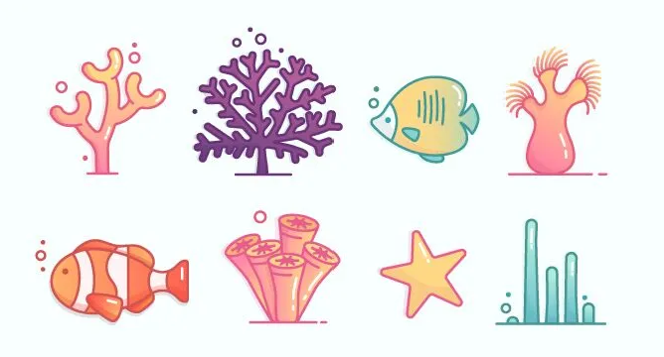
Congratulations!
Related Reading
TPO 47-3 Coral Reefs
TPO 17-1 Symbiotic Relationships
TPO 44-3 Seagrasses

